Slide 1
MICROSOFT .NET

Slide 2
What is .NET
.NET is a free, cross-platform, open source developer platform for building many different types of applications
created by Microsoft

Slide 3
Languages
You can write .NET apps in C#, F#, or Visual Basic.
C# is a simple, modern, object-oriented, and type-safe programming language.
F# is a cross-platform, open-source, functional programming language for .NET. It also includes object-oriented and imperative programming.
Visual Basic is an approachable language with a simple syntax for building type-safe, object-oriented apps.

Slide 4
Cross Platform
.NET Core is a cross-platform .NET implementation for websites, servers, and console apps on Windows, Linux, and macOS.
.NET Framework supports websites, services, desktop apps, and more on Windows.
Xamarin/Mono is a .NET implementation for running apps on all the major mobile operating systems.

Slide 5
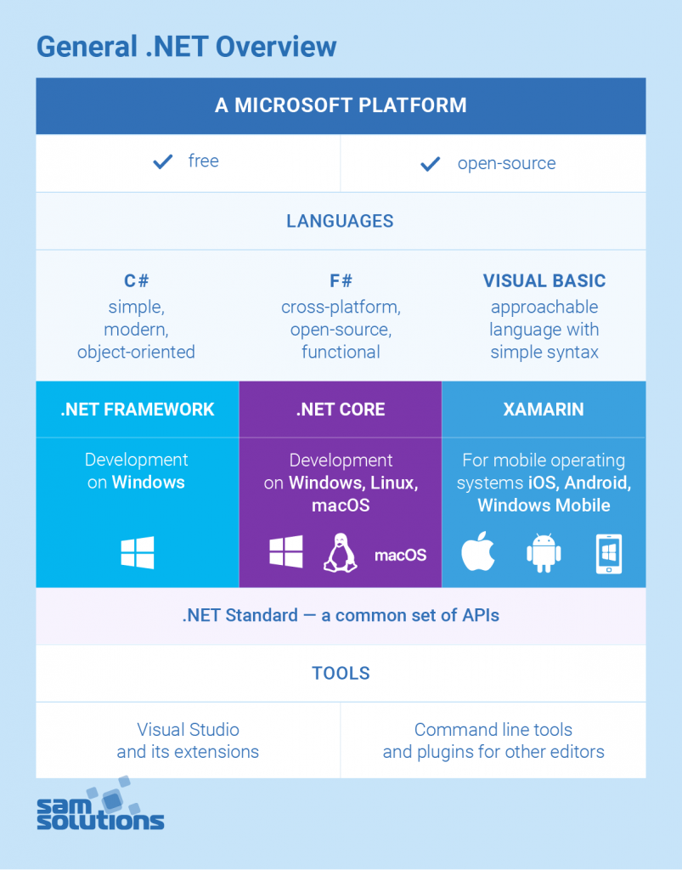

Slide 6
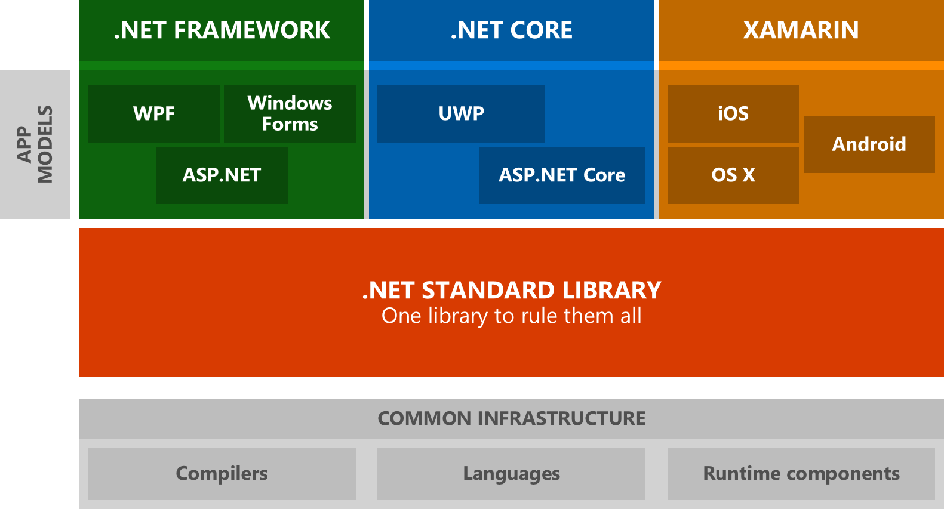

Slide 7
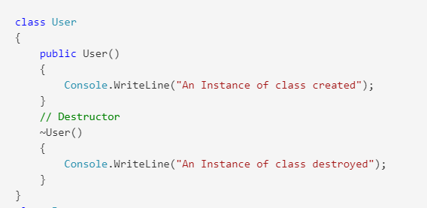
OOP
Object-oriented programming (OOP) is the core ingredient of the .NET
Classes and Objects
Constructor and Destructor
Function Overloading/Overriding
Encapsulation
Inheritance
Interface
Polymorphism

Slide 8
Common Language Runtime
Common Language Runtime (CLR) is a managed execution environment that is part of Microsoft’s .NET framework. CLR manages the execution of programs written in different supported languages.
CLR transforms source code into a form of bytecode known as Common Intermediate Language (CIL). At run time, CLR handles the execution of the CIL code.

Slide 9
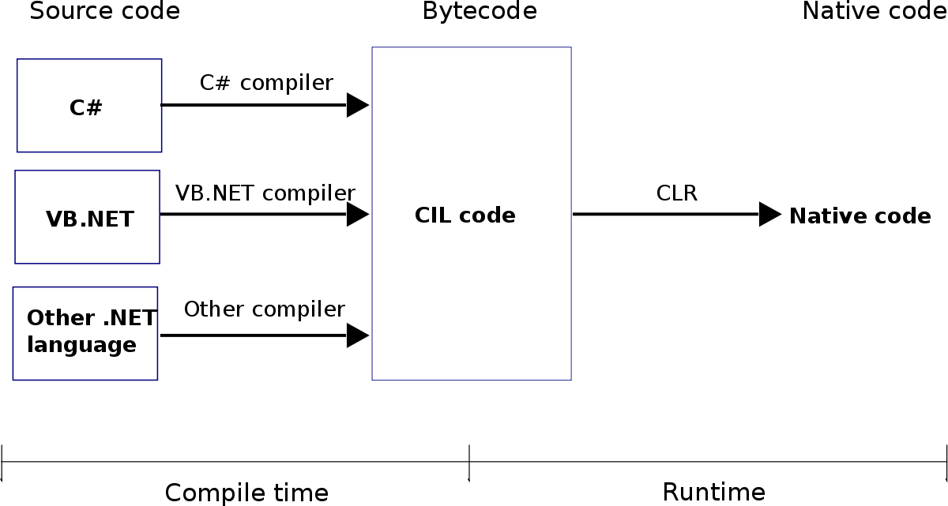

Slide 10
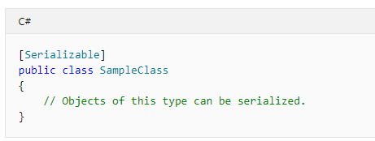
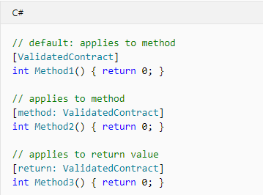
Attribute Programming
Attributes provide a powerful method of associating metadata, or declarative information, with code (assemblies, types, methods, properties, and so forth)

Slide 11
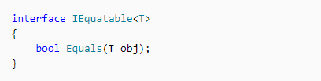
Interface-Based Programming
An interface is a reference type that is somewhat similar to an abstract base class that consists of only abstract members. When a class implements an interface, it must provide an implementation for all the members of the interface.
A class can implement multiple interfaces
You define an interface by using the interface keyword.

Slide 12
Types in .NET
All types in .NET are either value types or reference types.
Value types are data types whose objects are represented by the object's actual value. If an instance of a value type is assigned to a variable, that variable is given a fresh copy of the value.
Reference types are data types whose objects are represented by a reference (similar to a pointer) to the object's actual value. If a reference type is assigned to a variable, that variable references (points to) the original value. No copy is made.

Slide 13
Language interoperability
Language interoperability is the capability of two different programming languages to natively interact as part of the same system

Slide 14
Managed Code
managed code is just that: code whose execution is managed by a runtime.

